Slide 1

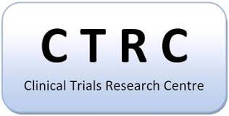
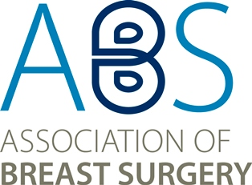



Surgeons’ lack of understanding of levels of evidence and trial methodology is a major barrier to RCTs in breast surgery.
G. Davies, N. Mills, C. Holcombe, S. Potter
Background
Notes:
Thanks very much for the opportunity to present my work at the SCT meeting. My name is Gareth Davies, and I’m a junior doctor and have been working at the University of Bristol. I thought I’d start by acknowledging the slightly provocative title to this talk, I thought it might help get a few extra bums on seats, and admitting that I am an aspiring surgeon myself, hopefully just about to start the surgical training pathway.

Slide 2
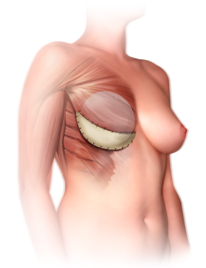

What is the problem?
Implant-based Breast Reconstruction
Notes:
My work is the result of a quaitative study I have undertaken in the field of IBBR, which is the most commonly offered reconstructive procedure in the UK for women who have had breast cancer and then undergone a mastectomy
In recent years, practice has evolved significantly with widespread uptake of new surgical techniques that allow reconstruction in a single operation as opposed to traditional techniques that require two separate procedures, providing significant potential advantages for patients and healthcare providers
Despite the rapid and widespread adoption of these techniques there is a lack of high quality outcome data world wide

Slide 3
Phases
National Practice Survey
Prospective Cohort Study
Mixed Methods Acceptability Study
Design of a Pragmatic RCT
Evaluating outcomes of
implant-based breast reconstruction
Notes:
This need for high quality evidence led to the design of the iBRA study. This 4 phase study aims to explore the feasibility, design, and conduct of a pragmatic RCT comparing the effectiveness of novel-approaches to IBBR.
My work represents the 3rd phase of the study, and…

Slide 4
Aims
Explore acceptability of proposed RCT designs
Identify potential barriers to RCT conduct
Inform design of a large-scale pragmatic RCT
Notes:
My aims were to explore the acceptability of various proposed RCT designs, to investigate possible barriers to RCT participation in the field and to explore how these challenges may be overcome, and hopefully finally to help inform the design of a definitive trial.

Slide 5

Semi-structured qualitative interviews
31 Healthcare professionals
Data analysed thematically
Concurrent sampling, data collection, & analysis until data saturation achieved
Methods
Notes:
Semi-structured telephone interviews with 31 clinicians involved in IBBR – primarily breast surgeons but also plastic surgeons performing these reconstructions and nurse specialists involved in the patients’ care
Interviews transcribed verbatim & data analysed thematically (constant comparative technique)
Sampling, data collection, & analysis all undertaken iteratively and concurrently until data saturation achieved

Slide 6
Limited evidence base
“Fundamentally, there is a question where we don’t know which is better and which is worse. It would be great to know that.”
Results
Notes:
A key finding was that overall the vast majority of participants acknowledged the paucity of evidence in the field and the need for high quality evidence. They identified that there was an important question that we needed to answer.
Similarly when speaking in general terms RCTs were almost universally identified as providing the gold-standard of evidence

Slide 7

Opposition to RCTs
Results
Notes:
Having said this, not everybody was supportive of the idea of an RCT in IBBR. Around a third of participants did not feel an RCT in the field was appropriate, achievable, or necessary. I’m really going to focus down on this cohort to try and illustrate what it transpired that the key barriers to trial implementation were, and possibly how this can be overcome.

Slide 8
Opposition to RCTs
Limited appreciation of the value of RCTs
Lack of equipoise
Inherent surgical culture
Results
Notes:
Much of the opposition revolved around three key themes; a limited appreciation of the value of RCTs, a lack of equipoise, and a culture within surgery that opposes trials and research more generally and I will discuss each of these in turn.

Slide 9
Limited appreciation of the value of RCTs
Systematic reviews &
Meta-analyses
RCTs
Cohort studies
Case control studies
Cross sectional surveys
Case studies
Ideas, expert opinions, editorials
Anecdotal
Notes:
So looking first of all at this limited appreciation of the value of randomised trials, despite initially stating that they provided the highest levels of evidence, some participants made it quite clear they did not fully appreciate the value of these over other study types.

Slide 10
Non-randomised studies sufficient
“Do we really, really need an RCT? I think we really, really need good data collection and to share our data … none of us need to re-invent the wheel”
“I think prospective audit is going to give you enough evidence,
as long as it is properly audited”
Results - Limited appreciation of the value of RCTs
Notes:
The benefit of randomisation in minimising bias was not always understood. Some suggested the same levels of evidence could be achieved by prospective audit, and another that by designing an RCT we were attempting to re-invent the wheel.

Slide 11
Surgery – lots of variables
“I do understand the value of it and the order of the hierarchy of the evidence, but it’s a handcraft discipline. It’s not like radiotherapy or oncology where you’re delivering a defined intervention. If, at the end of the day, the variables are so significant then any intelligent researcher would be asking the question, ‘What is the value? What are we trying to achieve here?’”
Results - Limited appreciation of the value of RCTs
Notes:
It was also highlighted that the variables present in surgery as a handcraft discipline would be so significant that they limit the value of any results from a trial. And often the concept of a pragmatic surgical trial was overlooked and not appreciated.

Slide 12
Surgery – lots of variables
“In terms of outcomes and things, to my knowledge there are no randomised controlled trials on outcomes, but part of me does think that a lot of this is an art as well as a science. So I think you can do trials. but I think also it's very much down to the individual patients and their skin quality.”
Results - Limited appreciation of the value of RCTs
Notes:
And there were also descriptions of surgery as an artform, implying that the results of trials cannot be extrapolated to individual patients in front of you.

Slide 13
Randomisation process
“The ladies love the idea of the trial, but they don’t want a computer to make that decision for them.”
Results - Limited appreciation of the value of RCTs
Notes:
Even the idea of randomisation itself was seen as a negative aspect in some cases. These participants felt that randomisation hindered recruitment to any studies as it was akin to a computer deciding a patient’s treatment pathway which probably reflected the way these surgeons explained trial methodology to their patients.

Slide 14

Lack of equipoise
Notes:
A lack of equipoise within IBBR emerged as a common theme.

Slide 15
Clinician equipoise
“I don’t see a reason to go back and do a pre-pectoral on a randomised controlled study … because I know that it’s not equal. I know pre-pectoral is a lot better.”
Results – Lack of equipoise
Notes:
Many clinicians strongly favoured one operative technique over another, they had strongly held views that ‘they know the techniques are not equal, and that one is a lot better than the other’

Slide 16
Patient choice
“There will be a group where you could do either, but you’ve also then got to factor in the patient’s preference. It’s not just the surgeon who’s got to have equipoise, it’s the patient.”
Results – Lack of equipoise
Notes:
Similarly, surgeons commonly cited a lack of patient equipoise as a barrier to trial conduct

Slide 17
Based on what?
“Personally if you ask me, I’d say I wouldn’t randomise patients. Although I couldn’t state that there is enough scientific evidence to prove it, in my limited experience which isn’t published … I still would say, ’I think it’s not something I’d want to do’”
Results – Lack of equipoise
Notes:
This lack of clinician equipoise was often based on non-randomised, single surgeon case series’ despite acknowledging the limited quality of this evidence.

Slide 18
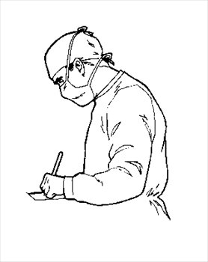
Inherent surgical culture
Notes:
This feeds well into the final theme that emerged, the underlying culture within surgery that opposes RCTs.

Slide 19
Guided by personal experience
“I think the sort of surgical mind-set is that during your training you see other people doing different things and you work out what you think is the best thing for whatever reason, without it really being evidence based or tested or audited in a kind of multicentre way. What works in your hands, works in your hands.”
Results – Inherent surgical culture
Notes:
It became apparent that a lot of what guides surgical technique is not a sound evidence base, but in fact personal experience. This was well highlighted by one professional highlighting surgical training as an apprenticeship where you learn what works “in your hands”.

Slide 20
Guided by personal experience
“Yes, well that’s the thing with surgeons isn’t it? It’s habit. If it’s always worked for you, it’s quite difficult not to do that.”
Results – Inherent surgical culture
Notes:
Similarly it was felt that actually getting surgeons to change their habits was quite difficult. That they become ingrained in their ways and when they feel something is working for them it can be very difficult to change operative technique

Slide 21
Limited appreciation of the value of RCTs
RCT in breast
surgery
Lack of equipoise
Inherent surgical culture
Conclusion
Notes:
So as I’ve already mentioned lots of the opposition to RCTs in breast surgery revolved around these three main themes.
Now, I realise I've painted a very gloomy picture here and I’m sure that some of you may have encountered much of this opposition yourself previously. This work in implant-based breast reconstruction has demonstrated that we possibly still have a long way to go to get full buy in from the surgical community before conducting a definitive trial.
However, I think the first thing to say is that I have specifically focussed on the views of those opposed to the idea of a randomised trial, to try and illustrate the thoughts of that group, and these were in fact in the minority. I also want to say that these barriers aren't unique to this field, they have been encountered in many other complex surgical trials that have been conducted successfully and are certainly not insurmountable despite what some of these clinicians may feel!

Slide 22


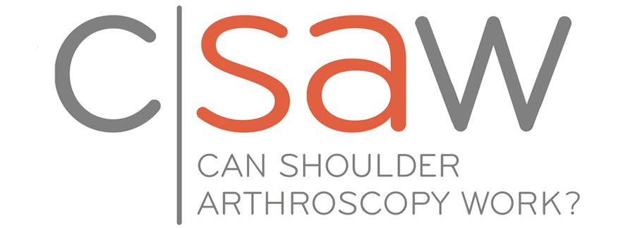

Surgical Trials Centres
Surgical Trainee Research Collaboratives
Overcoming barriers
Notes:
I’d like to think that things are moving in the right direction and there is a lot of work being done to improve the conduct of surgical trials.
You may have heard over the last couple of days of some of the fantastic work done by Professor Jenny Donovan’s Quintet research group also at the University of Bristol who have pioneered innovative ways to enhance and optimise recruitment to complex surgical trials. They have been involved in many successful complex surgical trials that were initially deemed not possible or that faced significant opposition.
And in the UK we also now have a network of surgical trials centres established by the Royal College of Surgeons of England, and there’s also a vast number of active Trainee Research Collaboratives that have had significant success demonstrating that the surgeons of the future are engaging in research and surgical trials.

Slide 23
“I think in this day and age you need to be practicing evidence-based surgery. You can’t just say, “Oh, but it works nicely in my hands.” That’s not good enough.”
“But we always need good quality evidence, and good quality evidence comes from randomised trials.”
“I think it's all about how you explain it to the patient, but it's absolutely achievable. If people say you can't do it, it's they can't do it. They're failing to do it. It's a communication skill that everyone should have and should learn.“
“If you're not offering [trials], you are depriving patients' choice.”
It is achievable!
Notes:
I’d like to think that things are moving in the right direction and I just wanted to leave you with some of the more positive comments to prove that the future of clinical trials is not all negative and there is some hope!

Slide 24

RCT in breast
surgery
RCT in breast
surgery
Presenter: Gareth.davies@doctors.org.uk
Supervisor: Shelley.potter@bristol.ac.uk
Any questions?

